Slide 1
7.3 Multi-class classification and the Perceptron

Slide 2
The Multi-class Perceptron cost function

Slide 3
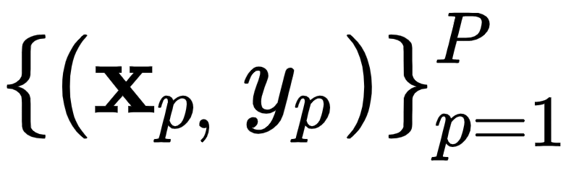
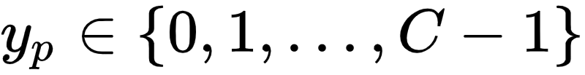
Once again we deal with an arbitrary multi-class dataset consisting of C distinct classes of data.
The labels for these classes can be made arbitrarily, but here we will once again employ label values

Slide 4
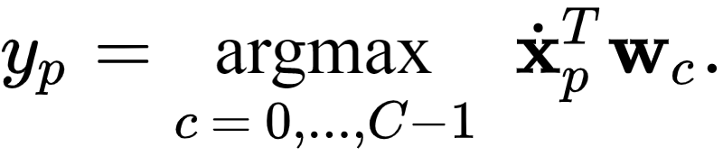
Recall the fusion rule
Our aim is (instead of tuning our each classifier's weights one-by-one and then combining them) to learn all sets of weights simultaneously so as to satisfy this ideal condition as often as possible.

Slide 5
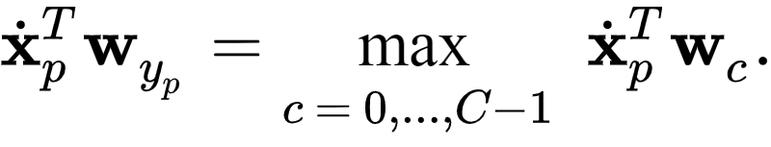
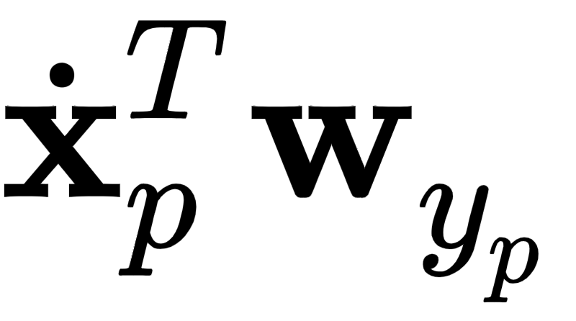
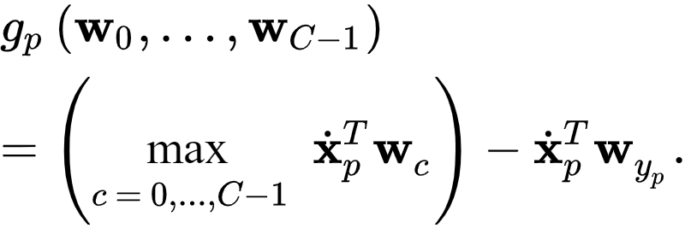
Let's slightly re-write the fusion rule:
Subtracting from both sides gives a point-wise cost that is always nonnegative and minimal at zero

Slide 6

Taking the average of this point-wise cost over the entire dataset we have
gives us the multi-class Perceptron cost function, which like its two class analog (see [Section 6.4]
is convex
has a trivial solution at zero (which is often avoided by initializing local optimization away from the origin).

Slide 7
Nomenclature and alternative formulations of the multi-class Perceptron

Slide 8
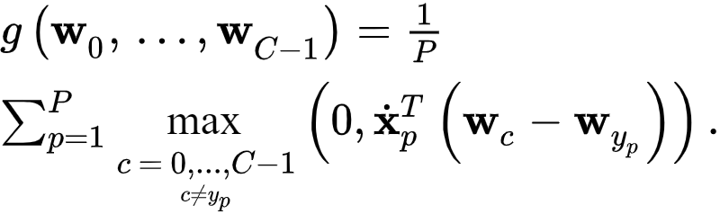
The multi-class Perceptron cost is a direct generalization of its two-class version introduced in [Section 6.4].
Hint: write the multi-class Perceptron cost in the following equivalent form

Slide 9
Regularization and the multi-class Perceptron

Slide 10
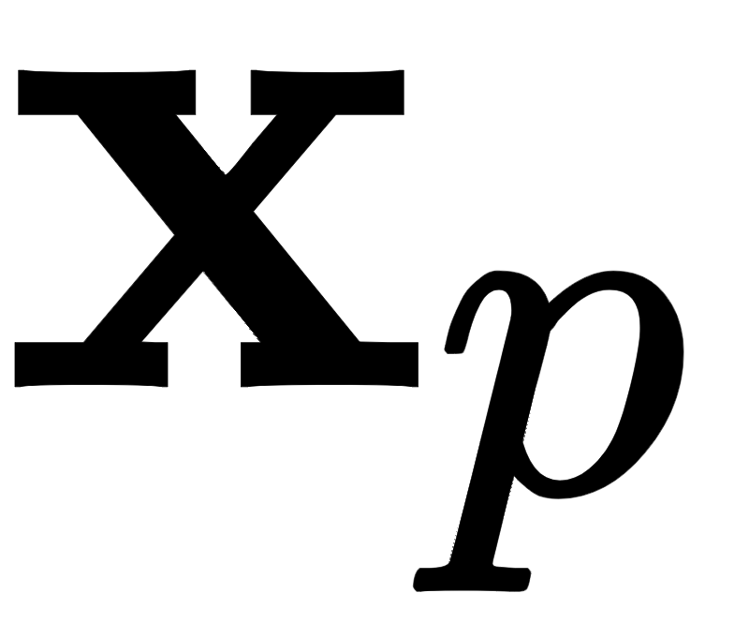
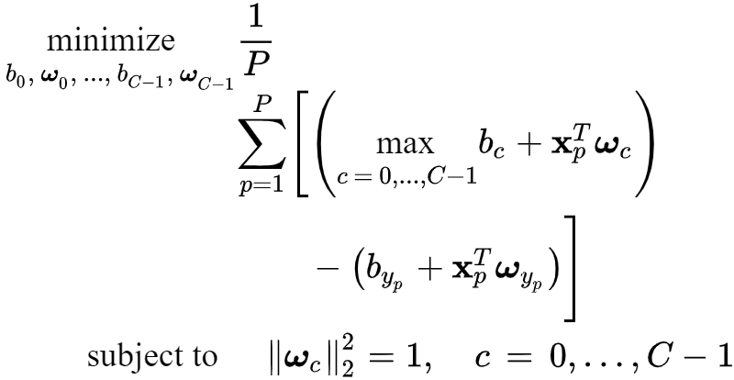
Recall that in order to fairly compare the distance of each input to our two-class decision boundaries, we should formally subject the cost to the constraints that all normal vectors have unit length.
Separating the biases from feature-touching weights, this leads to the following constrained problem

Slide 11
Although we can solve this problem directly (e.g., by using projected gradient descent), it is more commonplace to approximately solve it by relaxing the constraints (as we have seen before, e.g., in Sections [6.4.3] and [6.5.3]

Slide 12

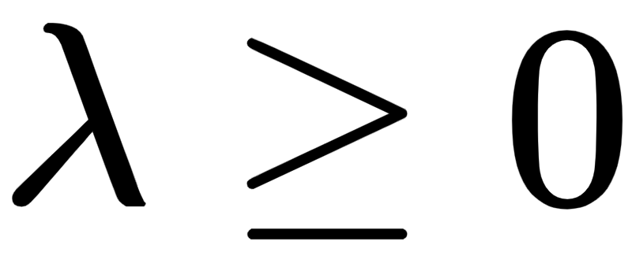
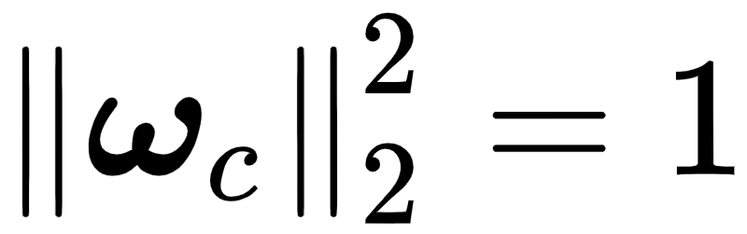
For simplicity we choose a single regularization parameter that is used to penalize the magnitude of all normal vectors simultaneously.
Even though this regularized form will not necessarily guarantee that for all ‘c’, it will generally force the length of all normal vectors to behave well, e.g., disallowing one normal vector to grow arbitrarily large while one shrinks to almost nothing.

Slide 13
Implementing and minimizing a modular multi-class Perceptron in `Python`

Slide 14
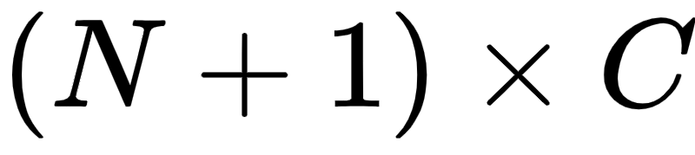
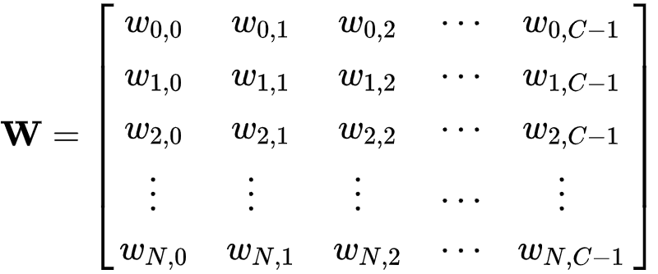
To take advantage of the `numpy` libraries fast array operations we use the notation first introduced in [Section 5.6.3] (and repeated in the previous Section), and stack the trained weights from our C classifiers together into a single array of the form

Slide 15
We extend our `model` notation to denote the evaluation of our $C$ individual linear models as

Slide 16
Note: ``Python`` code often runs much faster when ``for`` loops (or equivalently ``list comprehensions``) are written equivalently using matrix-vector ``numpy`` operations.

Slide 17
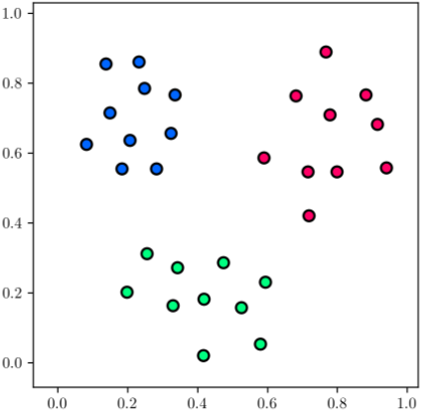
Example: multi-class perceptron

Slide 18
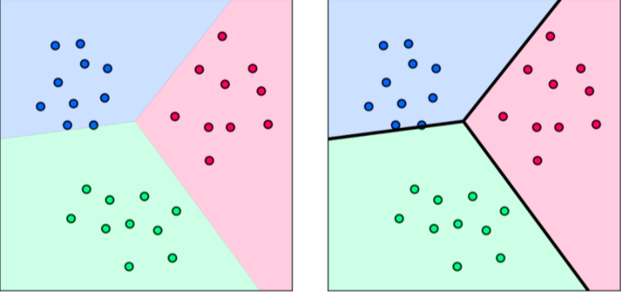

Slide 19
The Multi-class Softmax / Cross Entropy cost function

Slide 20
As was the case with the two-class perceptron, here too we can smooth the multi-class Perceptron cost employing the softmax function, defined as
which is a close and smooth approximation to the max function

Slide 21
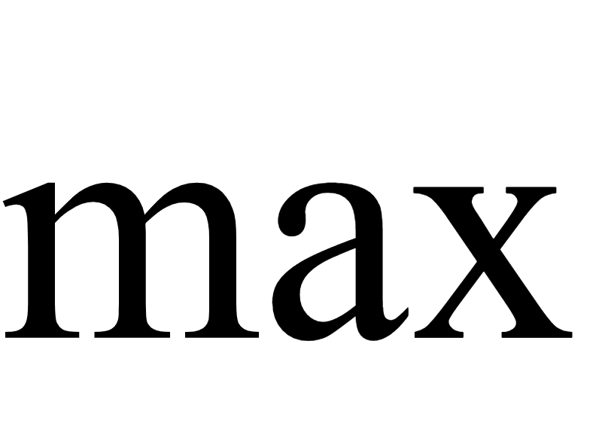
Replacing the function in each summand of the multi-class Perceptron gives
This is referred to as the multi-class Softmax cost function, which
is convex
unlike the Multiclass Perceptron has infinitely many smooth derivatives
no longer has a trivial solution at zero

Slide 22
Nomenclature and alternative formulations of the multi-class Softmax

Slide 23
This cost function goes by many names in practice including: the multi-class Softmax, Multiclass Cross Entropy, Softplus, and Multiclass Logistic cost to name a few.

Slide 24
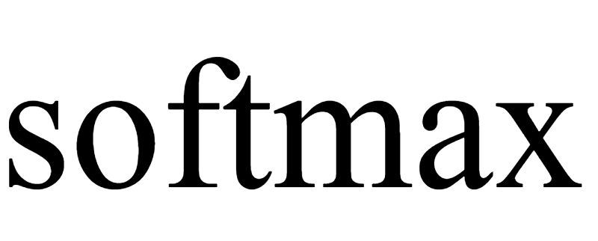

Why multi-class Softmax?
Because it is a softmax-smoothed version of the Multiclass Perceptron and because it is the natural generalization of the two-class version (see e.g., [Section 6.4.3].
Hint: replace the with the approximation to form

Slide 25
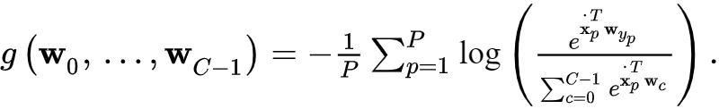
Why multi-class Cross Entropy?
Because - likewise - it is a natural generalization of the two class-version (see e.g., [Section 6.2]
Hint: write it - after some algebraic manipulation - as

Slide 26
Regularization and the multi-class Softmax

Slide 27
As with the multi-class Perceptron, it is common to regularize the Multiclass Softmax via its feature touching weights as

Slide 28
Implementing and minimizing a modular multi-class softmax in `Python`

Slide 29
Example: Multi-class Softmax on a toy dataset with C=3 classes

Slide 30
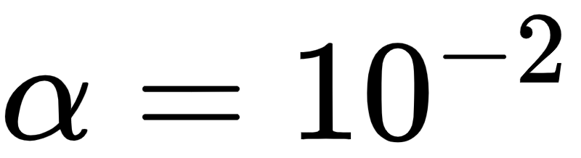
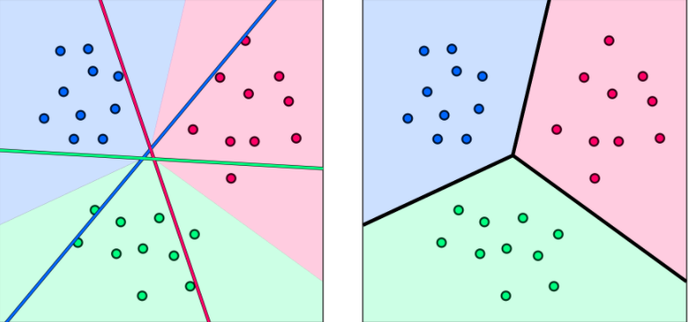
Gradient descent (200 iterations, )

Slide 31
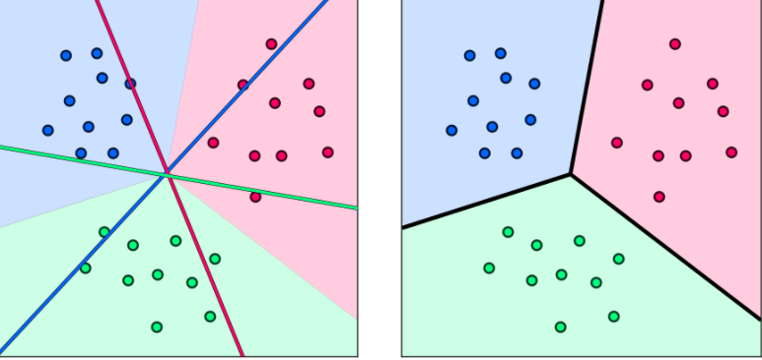
Newton's method (5 iterations)

Slide 32
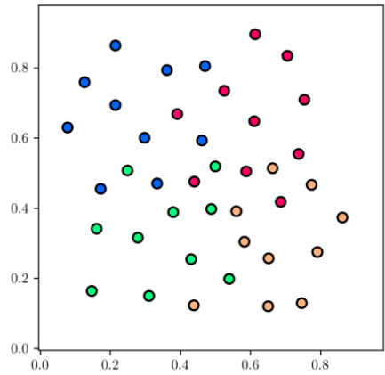
Example: Multi-class Softmax on a toy dataset with C = 4 classes

Slide 33
